Slide 2
Spark Joins:-
Basically when dealing with data in spark ,Spark internally performs some join operations on distributed engine in order to give massive parallelism and throughput.
So intelligently spark changes it action of course depending upon the Dataset and Volume consumption.
There are three types of joins in spark:-
1)Broadcast hash join
2)Shuffle hash join
3)Sort merge join

Slide 3
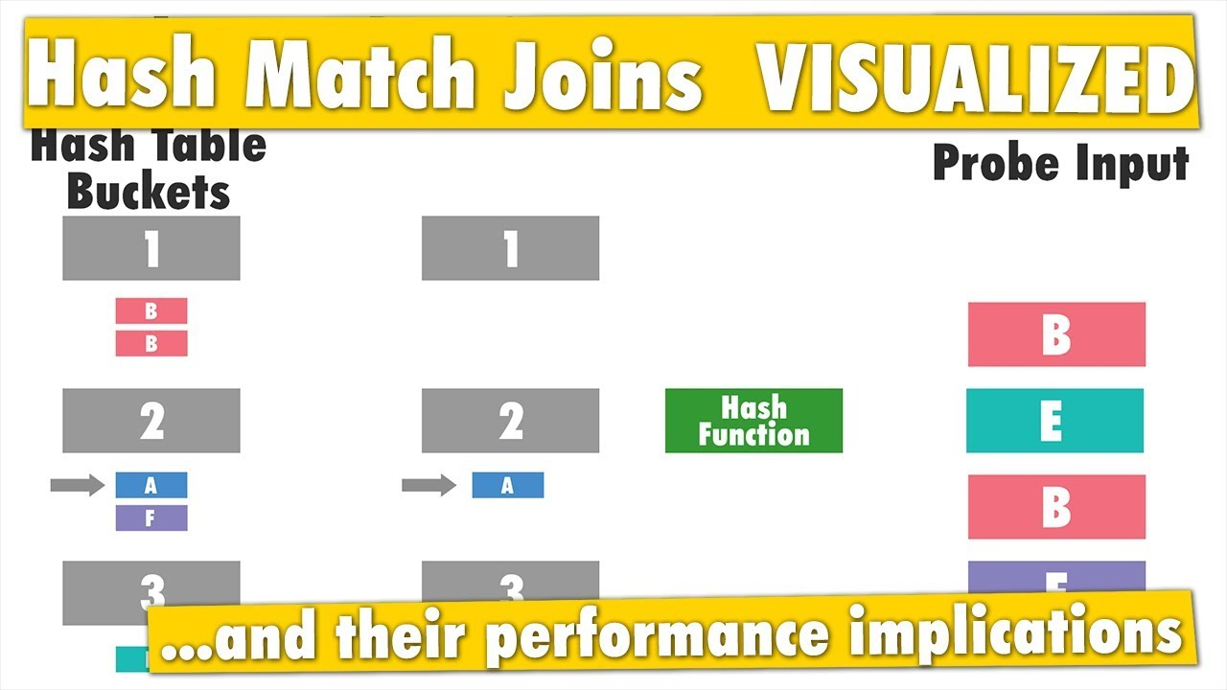
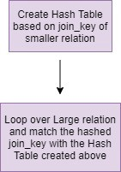
First of all Before learning Joins lets understand Hash Table-join
Hash join :-
The Hash Join algorithm is used to perform the natural join or equi join operations. The concept behind the Hash join algorithm is to partition the tuples of each given relation into sets.
The partition is done on the basis of the same hash value on the join attributes. The hash function provides the hash value.
The main goal of using the hash function in the algorithm is to reduce the number of comparisons and increase the efficiency to complete the join operation on the relations.

Slide 4
Broadcast Join:-
Broadcast join performs a join on two relations by first broadcasting the smaller one to all Spark executors, then evaluating the join criteria with each executor's partitions of the other relation.
In broadcast hash join, copy of one of the join relations are being sent to all the worker nodes and it saves shuffling cost. This is useful when you are joining a large relation with a smaller one. It is also known as map-side join(associating worker nodes with mappers).
Spark deploys this join strategy when the size of one of the join relations is less than the threshold values(default 10 M).
The spark property which defines this threshold spark.sql.autoBroadcastJoinThreshold(configurable).

Slide 5
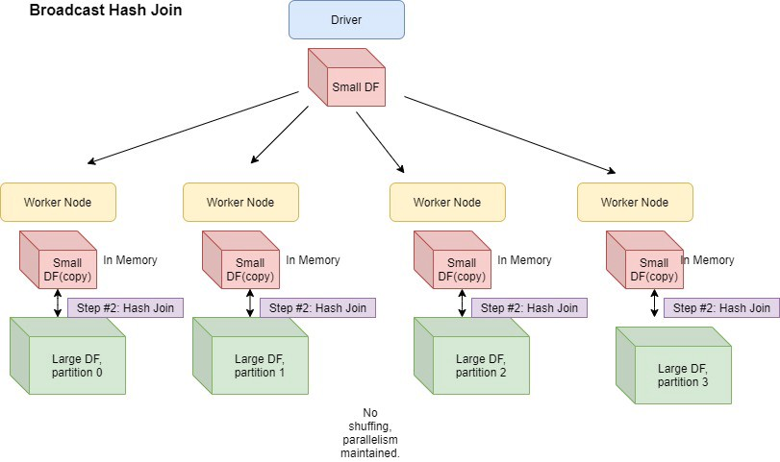

Slide 6
Shuffle Hash join:-
Shuffle Hash join:-
There are two phases
a)Shuffle Phase
b) Hash phase
Shuffle Phase:-
Second type of Join in Spark Joins is data gets shuffled o join key and move across the partitions.
Two tables have the same keys that end up with same partition so that join required on those data will be available in same partition
Hash Phase:-
The data on each partition performs a classic single nod hash join algorithm.
It reduces lookup time and join faster.

Slide 7
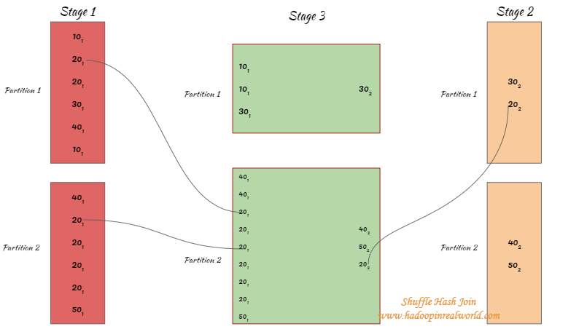
Shuffle Hash join – continue...

Slide 8
Shuffle Hash join – continue...
When Used:-
Any partition of build side could fit in memory.
One table is much smaller than other, the cost to build a hash table on smaller table is
Smaller than sorting larger table.
Issues:-
It breaks one big join of 2 smaller chunks of localized relatively smaller branch.
Shuffle is very expensive operation as it involves a lot of n/w intensive movement of data across the nodes of cluster.

Slide 9
Sort Merge Join:-
If the matching join keys are sortable and not eliglible for broadcast join or shuffle hash join.
It is very scalable approach and performs better than other joins most of the time
it can spill the data to disk and doesn’t require the entire data fit into memory.
It traits from Map-reduce Program.

Slide 10
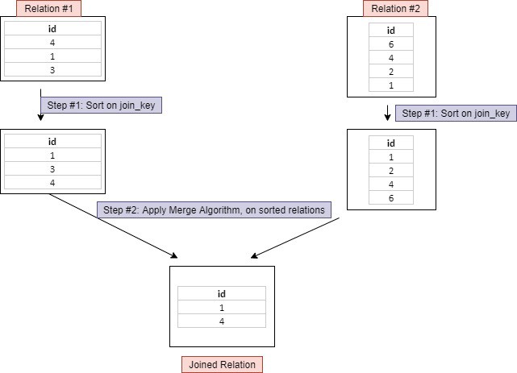
Sort Merge Join Continue.....

Slide 11
Sort Merge Join Continue.....
It has 3 phases:-
Shuffle phase:- two large tables are repartitioned as per the join keys across the partitions parallel.
Sort Phase:- Sort the data within each partition parallel.
Merge Phase:- Join the two sorted partitioned data This is basically merging of dataset by intergating over the elements by joining the rows having the same value for the join key.
Useful:-
Unwanted data shuffle.

Slide 12
Repartiton and Coalese:-
Repartition method can be used to either increase or decrease the number of partitions in a DataFrame.
Repartition is a full Shuffle operation, whole data is taken out from existing partitions and equally distributed into newly formed partitions.
Hence the amount of work is equally distributed among all the executors and better parallelism can be achieved.
Coalesce method reduces the number of partitions in a DataFrame.
Coalesce avoids full shuffle, instead of creating new partitions, it shuffles the data using Hash Partitioner (Default) and adjusts into existing partitions, this means it can only decrease the number of partitions.
Hence, some of the executors which have less amount of data to process will sit idle after completing the task assigned to them, and others with more data will be working.

Slide 13
Repartiton and Coalese continue...
If you have loaded a dataset, that includes huge data, and a lot of transformations that need an equal distribution of load on executors, you need to use Repartition. Before using repartition first check how many partitions are there
Ex. df.rdd.getNumPartitions()
Once all the transformations are applied and you want to save all the data into fewer files(no. of files = no.of partitions) instead of many files, use coalesce.
ex. df.coalesce(1).write.format('json').save('myfile.json')

Slide 14
Group By and Reduce By
On applying groupByKey() on a dataset of (K, V) pairs, the data shuffle according to the key value K in another RDD. In this transformation, lots of unnecessary data transfer over the network.
On applying reduceByKey on a dataset (K, V), before shuffling of data the pairs on the same machine with the same key are combined.
Spark provides the provision to save data to disk when there is more data shuffling onto a single executor machine than can fit in memory.

Slide 15
Group By and Reduce By continues...
Example:
val data = spark.sparkContext.parallelize(Array(('k',5),('s',3),('s',4),('p',7),('p',5),('t',8),('k',6)),3)
val group = data.groupByKey().collect()
group.foreach(println)
On applying reduceByKey on a dataset (K, V), before shuffling of data the pairs on the same machine with the same key are combined.
Example:
val words = Array("one","two","two","four","five","six","six","eight","nine","ten")
val data = spark.sparkContext.parallelize(words).map(w => (w,1)).reduceByKey(_+_)
data.collect.foreach(println)

Slide 16
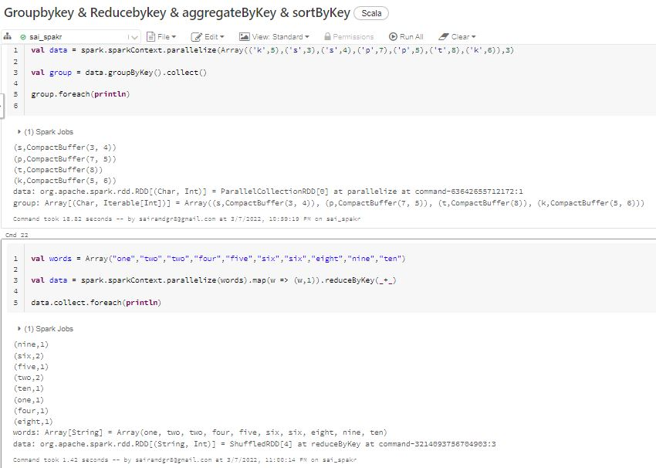
Group By and Reduce By continues...

Slide 17
Spark collect v/s take
Spark Dataframe: collect () vs select () Calling collect() on an RDD will return the entire dataset to the driver which can cause out of memory and we should avoid that.
Spark Take Function. In Spark, the take function behaves like an array. It receives an integer value (let say, n) as a parameter and returns an array of first n elements of the dataset.

Slide 18
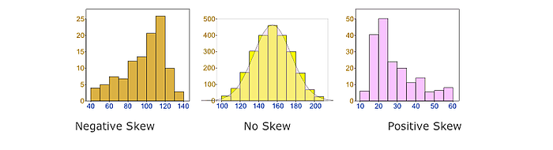
Skewness:-
Skewness is the statistical term, which refers to the value distribution in a given dataset. When we say that there is highly skewed data, it means that some column values have more rows and some very few, i.e., the data is not properly/evenly distributed. Data skewness affects the performance and parallelism in any distributed system. You can learn more about the use cases related to skewed data statistics

Slide 19
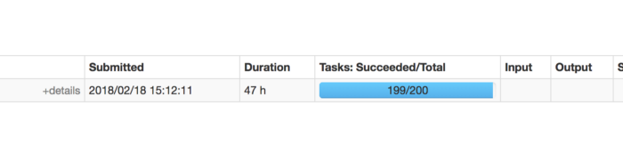
Skewness Continue....
Joining two or more large tables having skew data in Spark
While using Spark for our pipelines, we were faced with a use-case where we were required to join a large (driving) table on multiple columns with another large table on a different joining column and condition. The Spark join column was highly skewed, and the other table was an evenly distributed data frame. Both of these data frames were fairly large (millions of records). The job was getting stuck at the last stage (say at 399/400 steps) and stayed that way for 3 to 4 hours post, which threw an error that read- Caused by: org.apache.spark.shuffle.FetchFailedException: Too large frame: 7498008366. On the Spark Web App UI, we saw this-

Slide 20
Skewness Continue....
In Spark, SALT is a technique that adds random values to push Spark partition data evenly. It’s usually good to adopt for wide transformation requires shuffling like join operation.
The following image visualizes how SALT is going to change the key distribution. Key 1(light green) is the hot key that causes skewed data in a single partition. After applying SALT, the original key is split into 3 parts and driving the new keys to shuffle to different partitions than before. In this case, Key 1 goes to 3 different partitions, and the original partition can be processed in parallel among those 3 partitions.

Slide 21
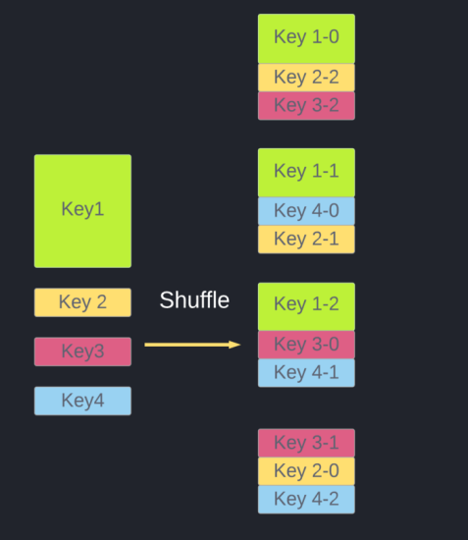
Skewness Continue....

Slide 22
Skewness Continue....
How to use SALT in Spark
The process of using SALT in Spark can be breakdown into:
Add a new field and populate it with random numbers.
Combine this new field and the existing keys as a composite key, perform any transformation.
Once the processing is done, combine the final result.
We can write a line of spark code like:
df.withColumn("salt_random_column", (rand * n).cast(IntegerType))
// n is the size of partition you'd like to have
.groupBy(groupByFields, "salt_random_column")
.agg(aggFields)
.groupBy(groupByFields)
.agg(aggFields)

Slide 23
Spark Cache v/s Persist
Spark Cache and persist are optimization techniques for iterative and interactive Spark applications to improve the performance of the jobs or applications.
Using cache() and persist() methods, Spark provides an optimization mechanism to store the intermediate computation of an RDD, DataFrame, and Dataset so they can be reused in subsequent actions reusing the RDD, Dataframe, and Dataset computation result’s.

Slide 24
Spark Cache v/s Persist continue....
Spark cache() method in Dataset class internally calls persist() method which in turn uses sparkSession.sharedState.cacheManager.cacheQuery to cache the result set of DataFrame or Dataset.
cache() : Dataset.this.type

Slide 25
Persist
Spark persist has two signature first signature doesn’t take any argument which by default saves it to MEMORY_AND_DISK storage level and the second signature which takes StorageLevel as an argument to store it to different storage levels.
1) persist() : Dataset.this.type 2) persist(newLevel : org.apache.spark.storage.StorageLevel) : Dataset.this.type

Slide 26
Persist continue....
All different storage level Spark supports are available at org.apache.spark.storage.StorageLevel class. The storage level specifies how and where to persist or cache a Spark DataFrame and Dataset.
MEMORY_ONLY – This is the default behavior of the RDD cache() method and stores the RDD or DataFrame as deserialized objects to JVM memory. When there is no enough memory available it will not save DataFrame of some partitions and these will be re-computed as and when required.

Slide 27
Persist continue....
MEMORY_ONLY_SER – This is the same as MEMORY_ONLY but the difference being it stores RDD as serialized objects to JVM memory. It takes lesser memory (space-efficient) then MEMORY_ONLY as it saves objects as serialized and takes an additional few more CPU cycles in order to deserialize.
MEMORY_ONLY_2 – Same as MEMORY_ONLY storage level but replicate each partition to two cluster nodes.
MEMORY_ONLY_SER_2 – Same as MEMORY_ONLY_SER storage level but replicate each partition to two cluster nodes

Slide 28
Persist continue....
MEMORY_AND_DISK – This is the default behavior of the DataFrame or Dataset. In this Storage Level, The DataFrame will be stored in JVM memory as a deserialized object. When required storage is greater than available memory, it stores some of the excess partitions into the disk and reads the data from the disk when required. It is slower as there is I/O involved.
MEMORY_AND_DISK_SER – This is the same as MEMORY_AND_DISK storage level difference being it serializes the DataFrame objects in memory and on disk when space is not available.

Slide 29
Persist continue....
MEMORY_AND_DISK_2 – Same as MEMORY_AND_DISK storage level but replicate each partition to two cluster nodes.
MEMORY_AND_DISK_SER_2 – Same as MEMORY_AND_DISK_SER storage level but replicate each partition to two cluster nodes.
DISK_ONLY – In this storage level, DataFrame is stored only on disk and the CPU computation time is high as I/O is involved.
DISK_ONLY_2 – Same as DISK_ONLY storage level but replicate each partition to two cluster nodes.

Slide 30
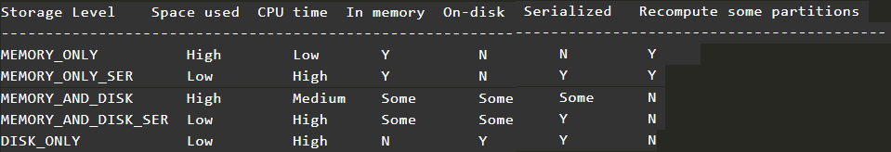
Persist continue....

Slide 31
Persist continue....
Unpersist syntax and Example
We can also unpersist the persistence DataFrame or Dataset to remove from the memory or storage.
Syntax
unpersist() : Dataset.this.type unpersist(blocking : scala.Boolean) : Dataset.this.type

